Slide 1
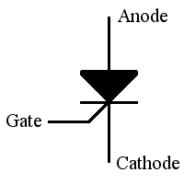
EEN-324
Power Electronics
Thyristor Devices
Silicon Controlled Rectifiers (SCR)
1

Slide 2
Power Semiconductor Switches
Power Diodes
Thyristors
2 layer device Device
Power Transistors
3 layer Device
4 layer
○
Thyristor devices can convert and control large amounts of power in AC or DC systems while using very low power for control.
Thyristor family includes
Silicon controlled switch (SCR)
Gate-turnoff thyristor (GTO) 3- Triac
Diac
Silicon controlled switch (SCS) 6- Mos-controlled switch (MCT)
○
2

Slide 3
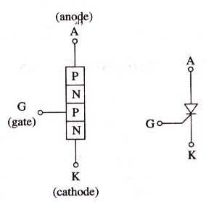
INTRODUCTION
○ SCR is most popular of thyristor family due to its
Fast switching action , small size and high voltage and current ratings.
○ It is commonly used in power electronic applications.
○
SCR has 3 terminals (gate provides control)
○
SCR is turned on by applying +ve gate sign when anode is +ve with repect to cathode.
al
○
SCR is turned off by interrupting anode current.
PNPN structure
Symbol
3

Slide 4
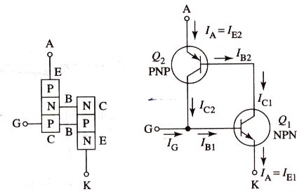
TWO TRANSISTOR MODEL OF SCR
○
Gate requires small positive pulse for short duration to turn SCR on. Once the device is on, the gate signal serves no useful purpose and can be removed.
4

Slide 5
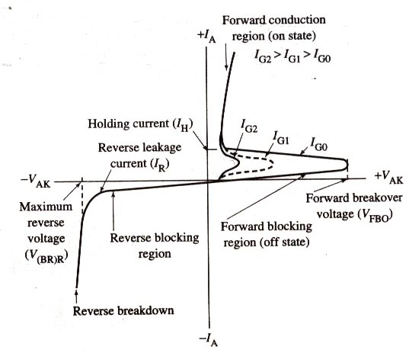
SCR CHARACTERISTIC CURVE
5

Slide 6
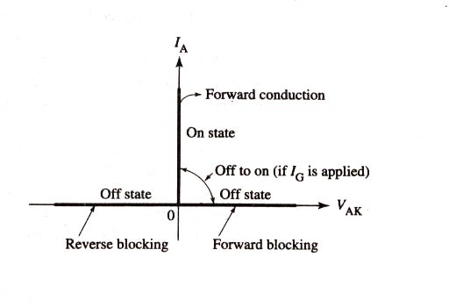
IDEAL CHARACTERISTIC OF SCR
6

Slide 7
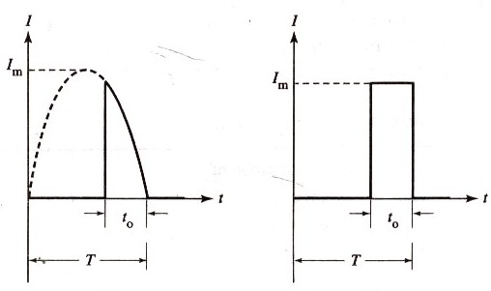
SCR RATINGS
(a) SCR Current Ratings
1- Maximum Repetitive RMS current Rating
○
Average on-state current is the maximum average current value that can be carried by the SCR in its on state.
RMS value of nonsinusoidal waveform is simplified by approximating it by rectangular waveform.
This approximation give higher RMS value, but leaves slight safety factor.
○
○
7

Slide 8
○ Average value of pulse is
○ Form factor is
8

Slide 9
○ Knowing the form factor for given waveform, RMS current can be obtained from
IRMS=fo(IAVE)
○ Maximum repetitive RMS current is given by
IT(RMS)=fo(IT(AVE))
○ Conduction angle verses form factor
Conduction angle | Form factor (fo)
(θ)
20° | 5.0
40° | 3.5
60° | 2.7
80° | 2.3
100° | 2.0
120° | 1.8
140° | 1.6
160° | 1.4
9

Slide 10
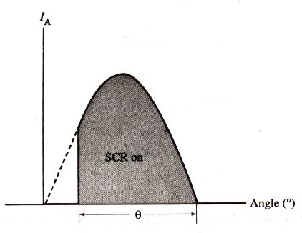
CONDUCTION ANGLE
○ Duration for which SCR is on. It is measured as shown

Slide 11
2- Surge Current Rating
Peak anode current that SCR can handle for brief duration.
Latching current
Minimum anode current that must flow through the SCR in order for it to stay on initially after gate signal is removed.
Holding Current
Minimum value of anode current, required to maintain SCR in conducting state.

Slide 12
(B) SCR VOLTAGE RATINGS
Peak repetitive forward blocking voltage
Maximum instantaneous voltage that SCR can block in forward direction.
Peak Repetitive Reverse Voltage
Maximum instantaneous voltage that SCR can withstand, without breakdown, in reverse direction.
Non-repetitive peak reverse voltage
Maximum transient reverse voltage that SCR can withstand.

Slide 13
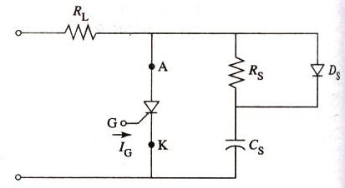
(C) SCR RATE-OF-CHANGE RATINGS
(di/dt rating)
Critical rate of rise of on-state current. It is the rate at which anode current increases and must be less than rate at which conduction area increases.
To prevent damage to SCR by high di/dt value, small inductance is added in series with device. Vaue of required inductance is
L>= Vp
(di/dt)max
dv/dt rating
Maximum rise time of a voltage pulse that can be applied to the SCR in the off state without causing it to fire. Unscheduled firing due to high value of dv/dt can be prevented by using RC snubber circuit.

Slide 14
(D) GATE PARAMETERS
Maximum Gate Peak Inverse Voltage
Maximum value of negative DC voltage that can be applied without damaging the gate- cathode junction.
Maximum Gate Trigger Current
Maximum DC gate current allowed to turn on the device.
Maximum gate trigger voltage
DC voltage necessary to produce maximum gate trigger current.
Maximum Gate Power Dissipation
Maximum instantaneous product of gate current and gate voltage that can exist during forward-bias.
Minimum gate trigger voltage
Minimum DC gate-to-cathode voltage required to trigger the SCR.
6-Minimum gate trigger current
Minimum DC gate current necessary to turn SCR on.
14

Slide 15
Series and Parallel
SCR Connections

Slide 16
SCRs are connected in series and parallel to extend voltage and current ratings.
For high-voltage, high-current applications, series- parallel combinations of SCRs are used.

Slide 17
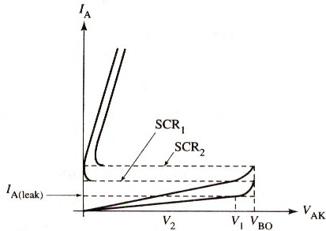
SCRS IN SERIES
○ Unequal distribution of voltage across two series SCRs.
○ Two SCRs do not share the same supply voltage. Maximum voltage that SCRs can block is V1+V2, not 2VBO.

Slide 18
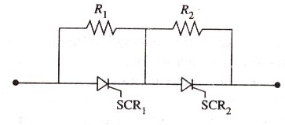
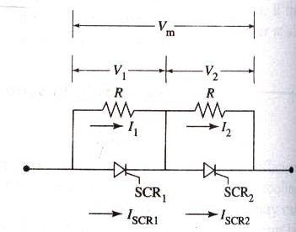
○
Resistance equalization
○
Voltage equalization

Slide 19
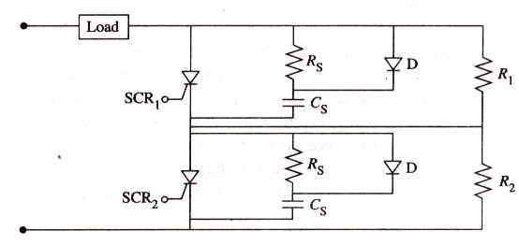
○
RC equalization for SCRs connected in series.

Slide 20
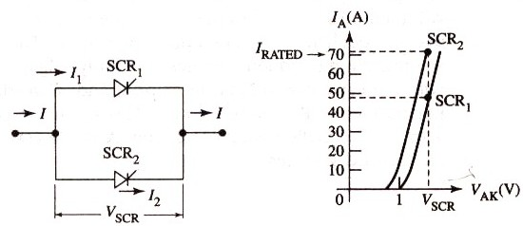
SCRS IN PARALLEL
○ Unequal current sharing between two SCRs is shown:
○ Total rated current of parallel connection is I1+I2, not 2I2.

Slide 21
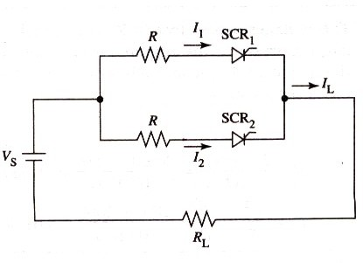
With unmatched SCRs, equal current sharing is achieved by adding low value resistor or inductor in series with each SCR, as shown below.
○
○
Value of resistance R is obtained from:
R=V1-V2
I2-I1

Slide 22
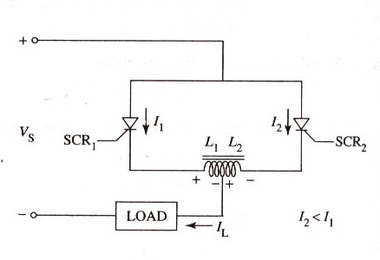
○ Current sharing in SCRs with parallel reactors
Equalization using resistors is inefficient due to
❖
❖
❖
Extra power loss
Noncompansation for unequal SCR turn-on and turn-off times. Damage due to overloading
SCRs with center-tapped reactors is shown below.

Slide 23
SCR Gate-Triggering
Circuits

Slide 24
○ Triggering circuits provide firing signal to turn on the SCR at precisely the correct time.
○ Firing circuits must have following properties
Produce gate signal of suitable magnitude and sufficiently short rise time.
Produce gate signal of adequate duration.
Provide accurate firing control over the required range.
Ensure that triggering does not occur from false signals or noise
In AC applications, ensure that the gate signal is applied when the SCR is forward-biased
In three-phase circuits, provide gate pulses that are 120° apart
with respect to the reference point
Ensure simultaneous triggering of SCRs connected in series or in parallel.

Slide 25
SCR Turnoff (Commutation)
Circuits

Slide 26
What is Commutation?
The process of turning off an SCR is called commutation.
It is achieved by
Reducing anode current below holding current
Make anode negative with respect to cathode
○ Types of commutation are:
Natural or line commutation
Forced commutation

Slide 27
SCR TURNOFF METHODS
Diverting the anode current to an alternate path
Shorting the SCR from anode to cathode
Applying a reverse voltage (by making the cathode positive with respect to the anode) across the SCR
Forcing the anode current to zero for a brief period
Opening the external path from its anode supply voltage
6. Momentarily reducing supply voltage to zero
38

Slide 28
Other members of
Thyristor Family

Slide 29
OTHER TYPES OF
THYRISTORS
Silicon Controlled Switch (SCS)
Gate Turnoff Thyristor (GTO)
DIAC
TRIAC
MOS-Controlled Thyristor (MCT)

Slide 30
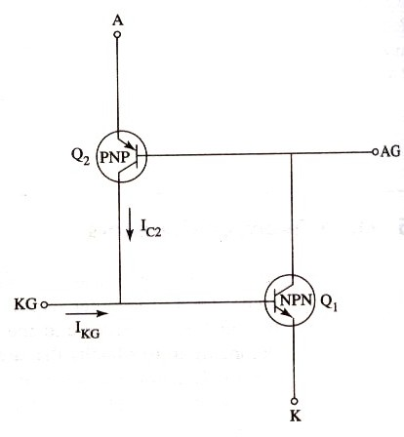
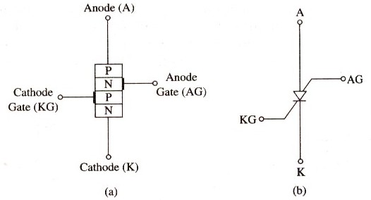
1. SCS
Structure
Symbol
Equivalent circuit for SCS

Slide 31
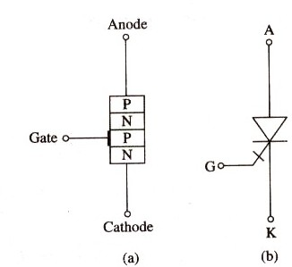
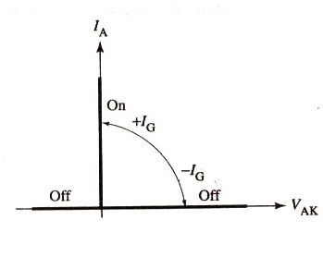
(2) GTO
Structure
Symbol
GTO Ideal VI characteristiccs

Slide 32
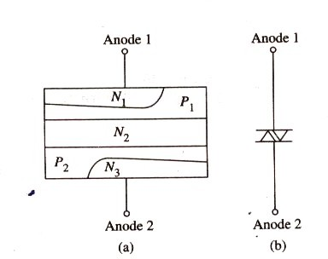
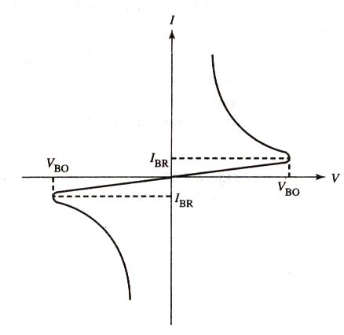
(3) DIAC
Structure
Symbol
VI characteristics of diac

Slide 33
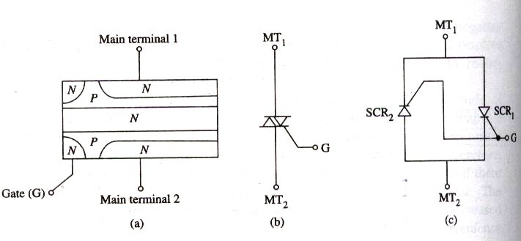
(4) TRIAC
Structure
Symbol
SCR equivalent circuit

Slide 34
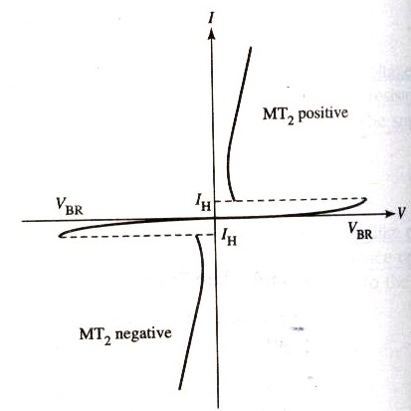
TRIAC VI CHARACTERISTICS

